Slide 1
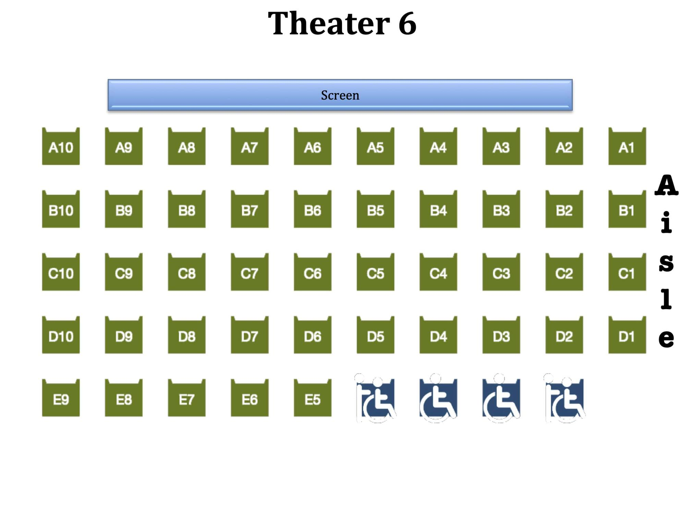
🔎
🎥
Movie Ticket app
Movie Ticket app ↻
12x🎟
🖤
🔎James Bond
Dan is chatting online late at night when a friend recommends the new James Bond movie.
Dan picks up his smartphone and opens the movie-ticket booking app from his home screen.
Inside the app, Dan searches for the James Bond movie at his local cinema and sees that it is showing.
Movie Ticket app
Movie Ticket app
Movie Ticket app
JAMES BOND:
-5:30pm - 3x🎟
-7 pm - 0x🎟
-8 pm - 15x🎟
JAMES BOND - 8pm:
✅Booking Confirmed
Accessibility:
- Hearing-aid compatible sound
- Assistance for wheelchairs
- Wheelchair compatible design
- [SS] Subtitles screens
🔊 Hearing aid support available
Dan chooses the 7pm showtime, but the app clearly tells him it is fully booked and suggests alternative times such as 5:30pm and 8pm.
Dan opens the seating plan for the 8pm showing; the seat map shows available seats, assistance seats, and clearly labelled rows
Dan selects his seats, checks that the cinema has hearing-aid compatible sound, confirms the booking, and sees a clear visual confirmation message.

